Slide 1






Modern Software Development Practices
Project Management Module
SESSION 2

Slide 2
Agenda
Context setting
Mega projects
Definition
Project management phases
Project management skills
Project Life Cycle

Slide 3


Slide 4
Recap of Previous Session

Slide 5
Project Management Tools
MS Project
MPP
Meetings(Skype, Webex)
Reports
Emails
Trello
JIRA
Confluence

Slide 6
Project Management Phases
Process Groups
Initiation
Closing
Planning
Executing
Monitoring & Control
Activities
Define a new project or new phase, identify stakeholders, and obtain authorization “Authorize the Work” | Develop an integrated project management plan to attain project objectives “Plan the Work” | Complete the work and satisfy project Objectives “Work the Plan | Track and review project progress and performance; manage variance and change “Control the Plan | Finalize all activities and formally close the project or phase “End the Work”
• Project Charter • Stakeholder Register | •Project Mgt. Plans & Related Documents - Scope - Requirements Schedule Cost Quality Human Resources Communication Risk Procurement Change Stakeholders | • Project Deliverables • Work Performance Data • Team Performance Assessments • Project Communications (e.g. status reports) • Selected Suppliers & Agreements • Change Requests • Issue Log | • Change Logs • Approved Change Requests • Work Performance Information • Schedule Forecasts • Cost Forecasts • Updates to Project Plan • Quality Control Measurements • Verified Deliverable • Accepted Deliverable | • Final Product, Service, or Result (i.e. purpose of project) • Closed Procurement (e.g. formal signature of acceptance)
Key Outputs

Slide 7

Initiation Phase
The Project Initiation Phase is the 1st phase in the Project Management Life Cycle, as it involves starting up a new project. You can start a new project by defining its objectives, scope, purpose and deliverables to be produced.
Major Setup during planning include
Project charter
Feasibility Study, Scope and Objectives
Organize Project team
Project Kick off
Project Management Plans
Establish clear statement of what is to be done (WBS)
Establish Risks to be Managed
Establish Costs and Durations
Establish Resources Required

Slide 8
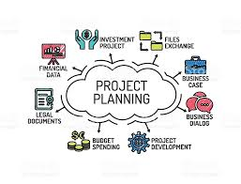
Planning Phase
Project Planning Phase – This phase includes the development of detailed plans required to manage the implementation of the project. Major steps during planned include :
1. Project Charter
2. Organize Project Team
3. Project Kick off
4. Project Management Plans
5. Project Plan Approval
6. Communicate Plans

Slide 9
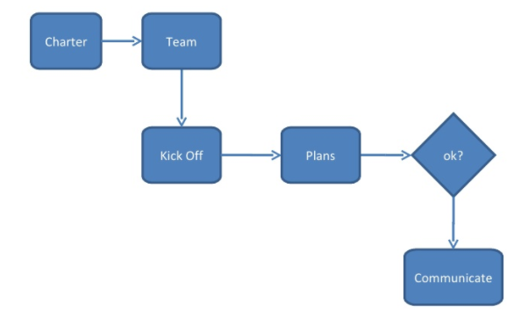
Project Planning

Slide 10
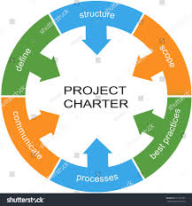
Project Charter
A project charter formally authorizes the project and the project manager to apply resources to project activities. Per PMI, without a charter, there is no project.
A typical charter will identify:
Business need or justification
Scope (high level)
Objectives (such as the intended product, service, or result)
Requirements (high level)
Risks (high level)
Assumptions and constraints
Stakeholders (primary)
Timing (anticipated)
Costs (anticipated)
The charter must be signed by someone who can invest authority for the project (typically senior management or a sponsor)

Slide 11
Project Management Plan
The project management plan is the collection of all plans and related documents pertaining to planning, executing, monitoring, controlling, and closing the project
Project Management Plan
Procurement
Risk
Configuration
Quality
Communication
Change
Scope
Cost
Process Improvement
Stakeholder
Schedule

Slide 12
Project Management Plan
Project Objectives, Scope, Deliverables
Stakeholders (Internal & External)
Work to be done (WBS)
Project Organization and Resources (OBS)
Project Costings (CBS)
Project Schedule
Scope Management
Risk Management
Quality management
Change Management

Slide 13
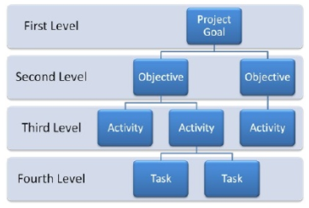
Scope Management
Scope Management includes the processes involved in defining and controlling all the activities that make up the project and that are required to complete the project successfully.

Slide 14

Scope Management
Scope Management involves four distinct steps:
Define the scope
Assign Work
Verify the Scope
Adapt the Scope

Slide 15

Scope Management
The Work Breakdown Structure (WBS) which is the management technique of breaking the project down into the
A hierarchy of work tasks which represent 100% of the work.
The Work Breakdown Structure is the foundation for effective project planning, costing and management.
It is the most important aspect in setting-up a Project
It is the foundation on which everything else builds

Slide 16
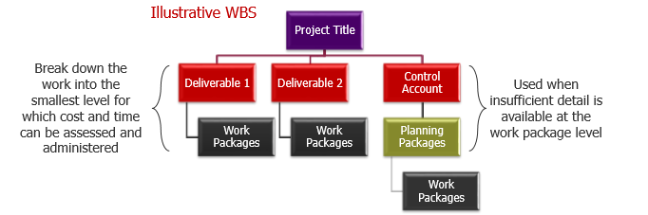
Work Breakdown Structure (WBS)
The WBS is the decomposition of the work to be performed. The output is called the Scope Baseline.
Scope Baseline:
•Scope Statement – description of project scope, major deliverables, assumptions, and constraints
•WBS – hierarchical decomposition of the total scope of work
•WBS Dictionary – provides details regarding the deliverables, activities, and scheduling information of each component of the WBS

Slide 17

Schedule Management
Schedule Management includes the development of a project schedule that contains all project activities, the project schedule is a communication tool that informs project stakeholders the status of the project and gives information as to when each activity must begin and end.
The key steps of the schedule management process are :
Define the schedule
Publish the schedule
Monitor the schedule
Update the schedule

Slide 18

Stakeholder Management
Stakeholders are all the people who have an interest in the project, they are the most critical element for the success of the project. They include donors, beneficiaries, partner organization and anyone who will be impacted by the project.

Slide 19
Stakeholder Management
There are four steps in stakeholder management process :
Stakeholder Mapping
Stakeholder relationship building
Stakeholder evaluation
Stakeholder management improvement

Slide 20
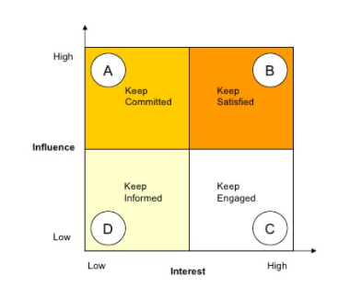
Stakeholder Management
An important tool on identifying stakeholders is the creation of a stakeholder map that places each stakeholder on the matrix of influence and interest.

Slide 21
Stakeholder Management
All the information accumulated in stakeholder analysis helps us in creating a Stakeholder Register. A register comprises of all the information in tabular form, whose size depends on the project size. It is the duty of the project manager to identify the potential stakeholders and note them down in the table, so as to ensure project success. Project Stakeholder Register is depicted in next slide.

Slide 22
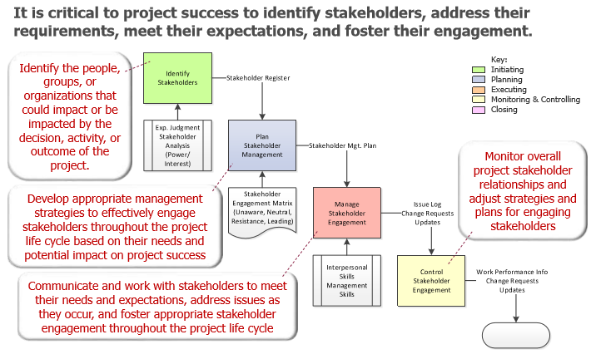
Stakeholder Management

Slide 23
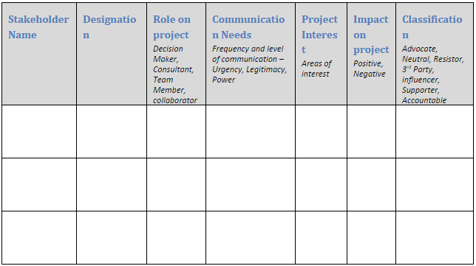
Exercise

Slide 24
Websites to look at as Project Management
https://www.pmi.org – Project Management
https://www.cebglobal.com/ -(PMO Leadership Council)
https://www.projectmanagement.com/- Webnairs
https://www.capterra.com/project-management-software/– Project Management Tools
https://www.slideshare.net/ostephens/project-management-tools-2014562- Project Management Tools
https://www.pmbypm.com/difference-project-program-and-portfolio/
https://www.youtube.com/watch?v=9LSnINglkQA
https://www.youtube.com/watch?v=6Or_9IRQHi4

Slide 25
Thank You

